Slide 1
AREN 304 SOIL MECHANICS
INSTRUCTOR: DR. -ING PEACE K. AMOATEY

Slide 2
Lecture 8 Permeability

Slide 3
Objectives
At the end of the lecture, students should understand:
the Bernouli equation as it applies to flow through soils
the definition of hydraulic gradient
understand permeability/hydraulic conductivity
how to determine hydraulic conductivity in the lab and on the field

Slide 4
Soil Permeability: A physical property

Slide 5
Flow of water through soil
Soils are assemblages of solid particles with interconnected voids where water can flow from a point of high energy to a point of low energy.
The study of flow water through porous media is important for stability analyses of earth retaining structures (retaining walls, earth dams) subjected to seepage force
There are 2 main issues
Quantity of water flowing that will be lost by percolation through a dam or its subsoil
Pore water pressures When water flows pore water pressures change.

Slide 6
What is Permeability?
The property of soils that allows flow of fluid through its interconnected void space at some rate.
It is a measure of how easily a fluid (e.g. water) can pass through the soil or the measure of the soil’s ability to permit water to flow through its pores or voids
This property is a product of the granular nature of the soil, although it can be affected by other factors (such as water bonding in clays).
Different soils have different permeabilities.

Slide 7
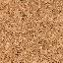
Importance of Permeability
The permeability of soils has a decisive effect on the :
Estimating the quantity of underground seepage under various hydraulic conditions,
for investigating problems involving the pumping of water for underground construction,
For making stability analyses of earth dams and earth-retaining structures that are subject to seepage forces.

Slide 8
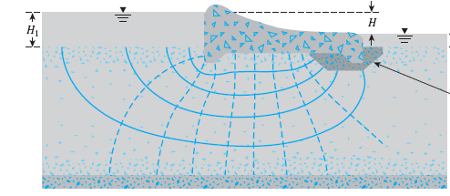
Importance of Permeability
Estimating the quantity of underground seepage
Solving problems involving pumping seepage water from construction excavation

Slide 9
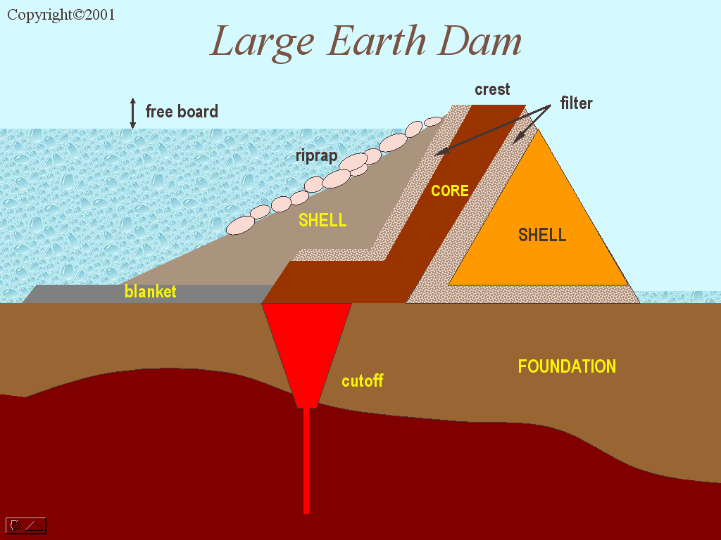
Importance of Permeability
Design of filters

Slide 10
Flow through a Dam
Estimating the quantity of water through a dam
Unsaturated
Soil
Flow of water

Slide 11
Bernoulli’s Equation
Bernoulli's Principle states that as the speed of a moving fluid increases, the pressure within the fluid decreases.
The energy of fluid comprise of:
Potential energy: due to elevation (z) with respect to a datum
Pressure energy: due to pressure
Kinetic energy: due to velocity
fluid particle
z
datum

Slide 12
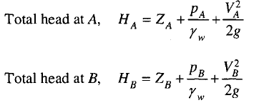
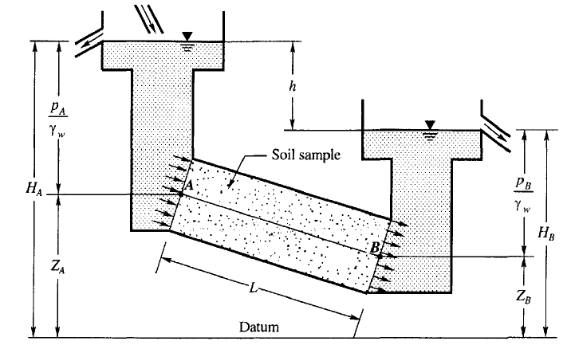
Bernoulli’s Equation
The total head at any point in water under steady flow condition may be expressed as :
Total head = pressure head + velocity head + elevation head

Slide 13
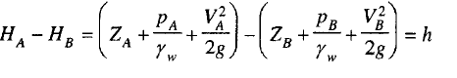
Definition of Hydraulic Gradients
As the water flows from A to B, there is an energy loss which is represented by the difference in the total heads HA, and HD
where, P_{A} and P_{B} = pressure heads, V_{A} and V_{B} = velocity, g - acceleration due to gravity, γ_{w} = unit weight of water, h = loss of head.
For all practical purposes the velocity head is a small quantity and may be neglected.
The loss of head of h units is effected as the water flows from A to B. The loss of head per unit length of flow may be expressed as:
i = h/L
where i is called the hydraulic gradient.

Slide 14
Definition of Hydraulic Gradient
In the field, the gradient of the head is the head difference over the distance separating the 2 wells
In the field, the gradient of the head is the head difference over the distance separating the 2 wells.

Slide 15
Definition of Hydraulic Gradient
A
Impervious Soil
W.T.
h = h_{A} - h_{B}
pervious Soil
L
W.T.
h_{A} = total head
B
Impervious Soil
h_{B}= total head
Datum

Slide 16
Definition of Hydraulic Gradient
W.T.
Impervious Soil
)h = h_{A} - h_{B}
Water In
h_{A}
W.T.
Datum
Impervious Soil
h_{B}
Head Loss or
Head Difference or Energy Loss
h =h_{A} - h_{B}
i = Hydraulic Gradient
h_{A}
Pressure Head
Total Head
(q)
Water
out
Pressure Head
A
h_{B}
Soil
Total Head
B
Elevation Head
L = Drainage Path
Z_{A}
Elevation Head
Z_{B}
Datum

Slide 17
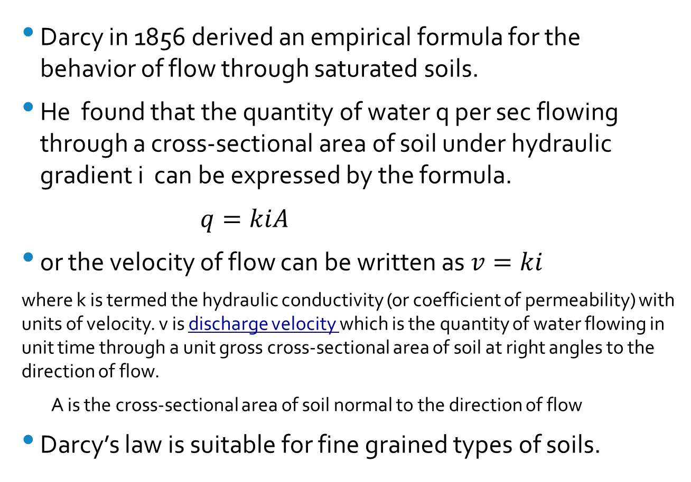
DARCY'S LAW
Darcy in 1856 derived an empirical formula for the behavior of flow through saturated soils.
He found that the quantity of water q per sec flowing through a cross-sectional area of soil under hydraulic gradient i can be expressed by the formula.
$q=kiA$
or the velocity of flow can be written as $v=ki$
where k is termed the hydraulic conductivity (or coefficient of permeability) with units of velocity. v is discharge velocity which is the quantity of water flowing in unit time through a unit gross cross-sectional area of soil at right angles to the direction of flow.
A is the cross-sectional area of soil normal to the direction of flow
Darcy’s law is suitable for fine grained types of soils.

Slide 18
Darcy’s Law: Water flow through soil
Soil Sample
Flow (volume per unit time) was
proportional to the head difference Dh
proportional to the cross-sectional area A
inversely proportional to the length of sample DL

Slide 19

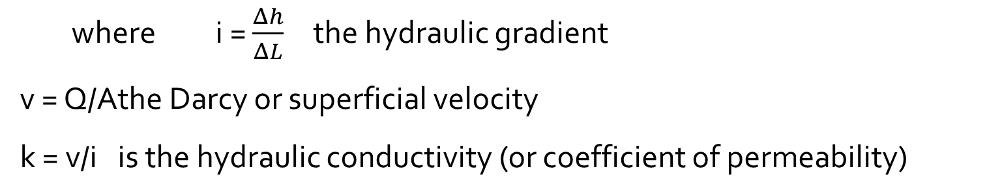
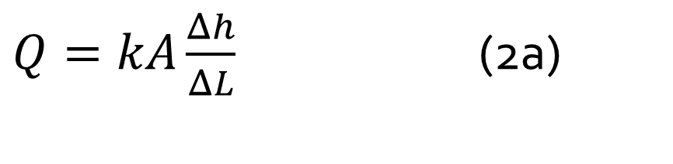
Darcy’s Law: Water flow through soil
$Q=kA\frac{Δh}{ΔL}$ (2a)
Thus
Then the quantity of water flowing through the soil per unit time is
Equation (2a) may be written as
$$Q=kA$$
$$v=ki$$
where i = $\frac{Δh}{ΔL}$ the hydraulic gradient
v = Q/A the Darcy or superficial velocity
k = v/i is the hydraulic conductivity (or coefficient of permeability)

Slide 20
Determination of hydraulic conductivity of soils
The hydraulic conductivity k is a measure of how easy the water can flow through the soil.
The hydraulic conductivity is expressed in the units of velocity (such as cm/sec and m/sec).
Methods that are in common use for determining the coefficient of permeability k can be classified as:
Laboratory methods: Constant head permeability method and falling head permeability method
Field methods: Pumping tests, Bore hole tests
Indirect Method: Empirical correlations

Slide 21
Laboratory Measurement of Permeability
inlet
constant head
device
load
H
Manometers
outlet
device for flow
measurement
sample
L
porous disk
Fig. 4 Constant Head Permeameter

Slide 22
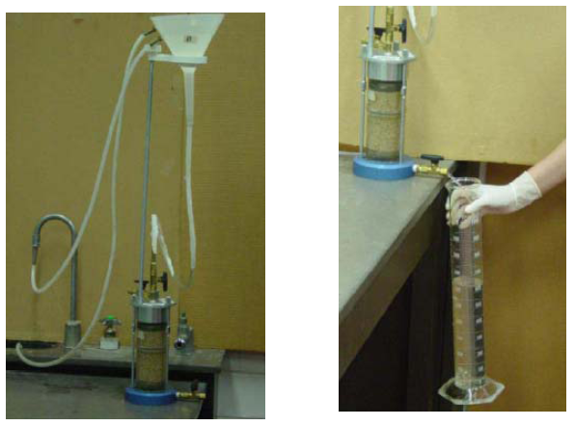
Constant Head Test
Notes:
For coarse-grained soils

Slide 23
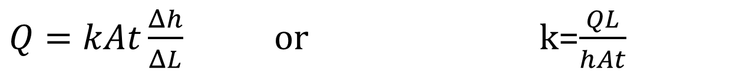
Constant Head Permeability Test
The sample of length L and cross-sectional area A is subjected to a head h which is constant during the progress of a test.
A test is performed by allowing water to flow through the sample and measuring the quantity of discharge Q in time t.
The constant head permeameter test is more suited for coarse grained soils such as gravelly sand and coarse and medium sand.
$Q=kAt\frac{Δh}{ΔL}$ or k=$\frac{QL}{hAt}$

Slide 24

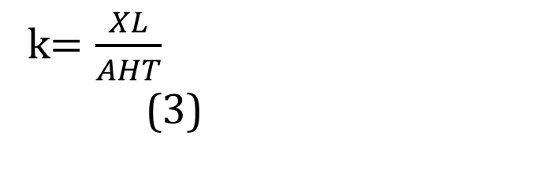
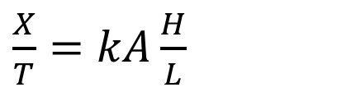
Constant Head Permeameter
The volume discharge X during a suitable time interval T is collected.
The difference in head H over a length L is measured by means of manometers.
Knowing the cross-sectional area A, Darcy’s law gives
It can be seen that in a constant head permeameter:
$\frac{X}{T}=kA\frac{H}{L}$
k$=\frac{XL}{AHT}$ (3)

Slide 25
Laboratory Measurement of Permeability
Standpipe of
cross-sectional
area a
The falling head test is
mainly for fine-grained
soils.
porous disk
H₁
H
Sample
of area A
H₂
L
Fig. 5 Falling Head Permeameter

Slide 26
Falling Head Permeameter
Analysis
Standpipe
of area
a
Consider a time interval dt
The flow in the standpipe =
H₁
The flow in the sample =
H
and thus
H₂
Sample
of area
A
L
(4a)

Slide 27
Falling Head Permeameter
Solution
Standpipe
of area
a
dH
H
−
a
=
kA
dt
L
(4
a)
Equation (4a) has the solution:
H₁
kA
H
−
a
l
n
(
H
)
=
t
+
cons
tan
t
(4
b)
L
Sample
of area
A
H₂
L
Initially H=H
at time t=t
1
1
Finally H=H
at time t=t
2
2.
(4
c)
aL
l
n
(
H
/
H
)
k
=
1
2
A
t
−
t
2
1

Slide 29
Typical Permeability Values
10⁻¹
10⁻²
10⁻³
10⁻⁴
10⁻⁵
10⁻⁶
10⁻⁷
10⁻⁸
10⁻⁹
10⁻¹⁰
10⁻¹¹
10⁻¹²
Gravels
Sands
Silts
Homogeneous Clays
Fissured & Weathered Clays
Typical Permeability Ranges (metres/second)
Soils exhibit a wide range of permeabilities and while particle size may vary by about 3-4 orders of magnitude permeability may vary by about 10 orders of magnitude.

Slide 30
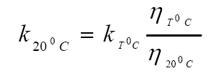
Hydraulic Conductivity
Hydraulic conductivity of soils depends on several factors:
Fluid viscosity (h): as the viscosity increases, the hydraulic conductivity decreases
Pore size distribution
Temperature
Grain size distribution
Degree of soil saturation
It is conventional to express the value of k at a temperature of 20ºC.

Slide 31
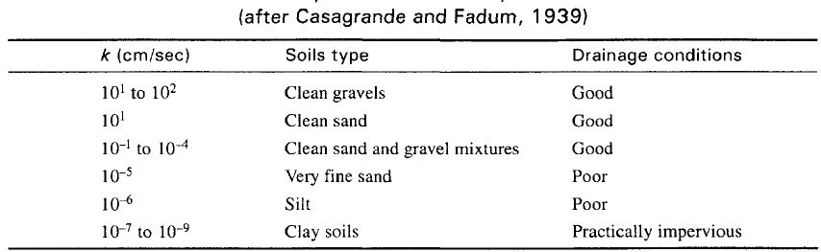
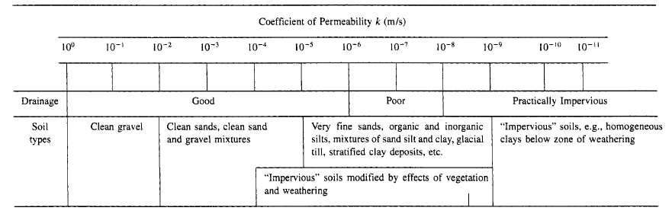
Hydraulic conductivity of some soils

Slide 32
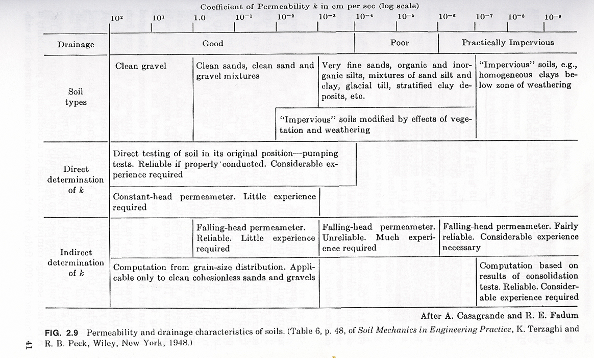
Hydraulic Conductivity, k

Slide 33
Field Determination of Hydraulic Conductivity
Steps
Water is pumped out at a constant rate from a test well that has a perforated casing.
several observation wells at various radial distances are made around the test well.
Continuous observations of the water level in the test well and in the observation wells are made after the start of pumping, until a steady state is reached.
The steady state is established when the water level in the test and observation wells becomes constant.

Slide 34
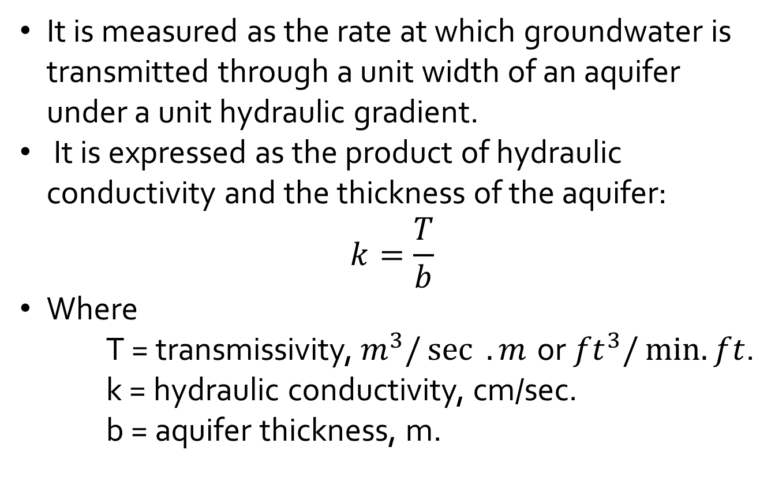
Transmissivity
It is measured as the rate at which groundwater is transmitted through a unit width of an aquifer under a unit hydraulic gradient.
It is expressed as the product of hydraulic conductivity and the thickness of the aquifer:
$$k=\frac{T}{b}$$
Where
T = transmissivity,${ m}^{3}/\sec{ . m}$ or${ ft}^{3}/\min{. ft}$.
k = hydraulic conductivity, cm/sec.
b = aquifer thickness, m.

Slide 35
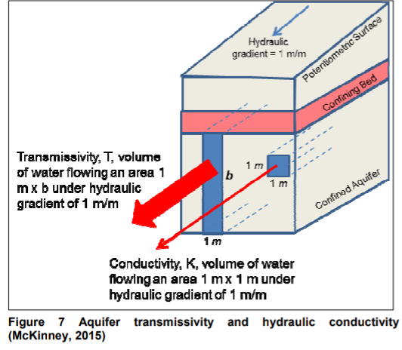
Transmissivity

Slide 36
Pumping Well with Observation Holes
In the field, the average hydraulic conductivity of a soil deposit in the direction of flow can be determined by performing pumping tests from wells.
The top permeable layer, whose hydraulic conductivity has to be determined, is unconfined and underlain by an impermeable layer.
During the test, water is pumped out at a constant rate from a test well that has a perforated casing.
Several observation wells at various radial distances are made around the test well.

Slide 37
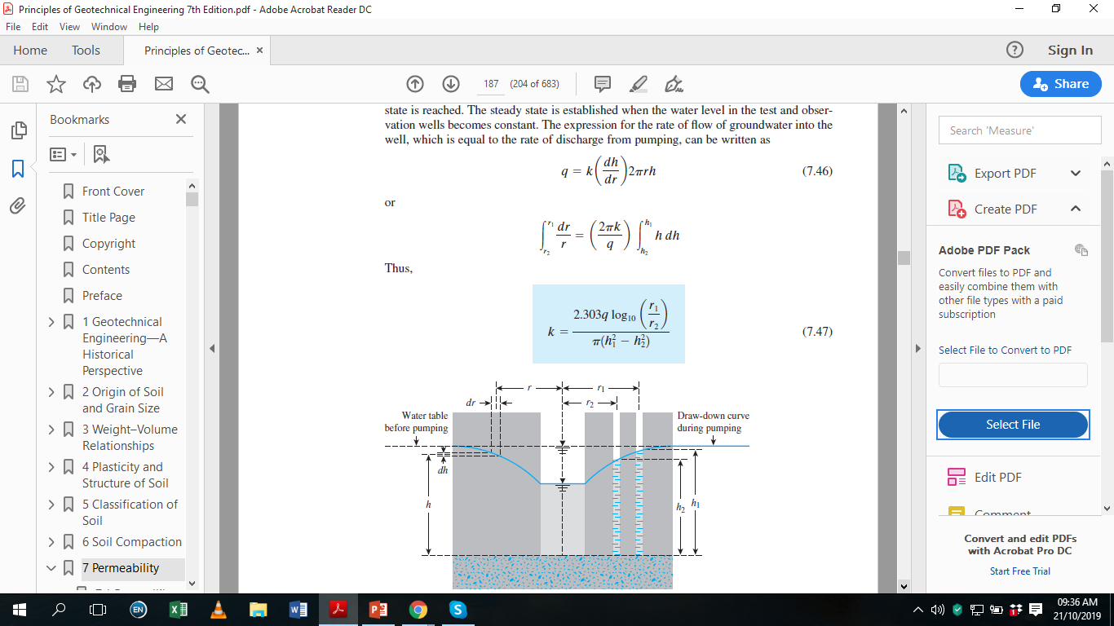
Pumping Well with Observation Holes
Continuous observations of the water level in the test well and in the observation wells are made after the start of pumping, until a steady state is reached.
The steady state is established when the water level in the test and observation wells becomes constant.
The expression for the rate of flow of groundwater into the well, which is equal to the rate of discharge from pumping, can be written as:

Slide 38
Pumping Well with Observation Holes
Continuous observations of the water level in the test well and in the observation wells are made after the start of pumping, until a steady state is reached.
The steady state is established when the water level in the test and observation wells becomes constant.
The expression for the rate of flow of groundwater into the well, which is equal to the rate of discharge from pumping, can be written as:

Slide 39
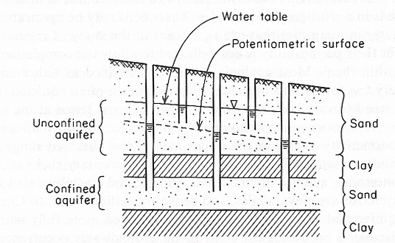
Pumping Well with Observation Holes
Aquifer: Soil or rock forming stratum that is saturated and permeable enough to yield significant quantities of water (e.g. sands, gravels, fractured rock)
Unconfined Aquifer (water table aquifer) is an aquifer in which the water table forms the upper boundary.
Confined Aquifer is an aquifer confined between two impervious layers (e.g. clay).

Slide 40
Summary
1. The flow of water through soils is governed by Darcy's law, which states that the average flow velocity is proportional to the hydraulic gradient.
2. The proportionality coefficient in Darcy's law is called the coefficient of permeability or hydraulic conductivity, k.
3. The value of k is influenced by the void ratio, particle size distribution, and the wholeness of the soil mass.
4. Homogeneous clays are practically impervious while sands and gravels are pervious.

Slide 41
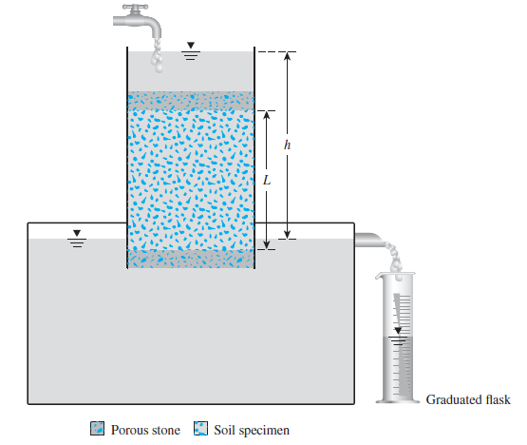
EXAMPLES
The constant-head permeability test arrangement shown below. A test gives these values:
L = 30 cm
• A = area of the specimen = 177 cm²
• Constant-head difference, h =50 cm
• Water collected in a period of 5 min =350 cm³
Calculate the hydraulic conductivity in cm/sec.

Slide 42
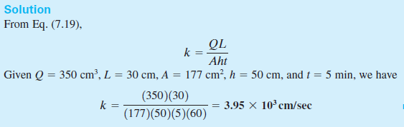
EXAMPLES
Given that:
L = 30 cm
• A = area of the specimen = 177 cm²
• Constant-head difference, h =50 cm
• Water collected in a period of 5 min =350 cm³

Slide 43
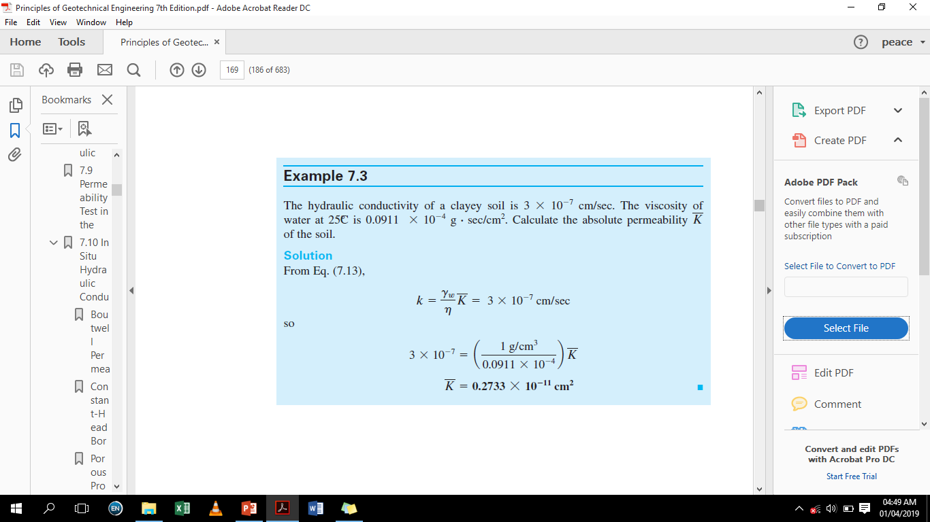
Examples

Slide 44
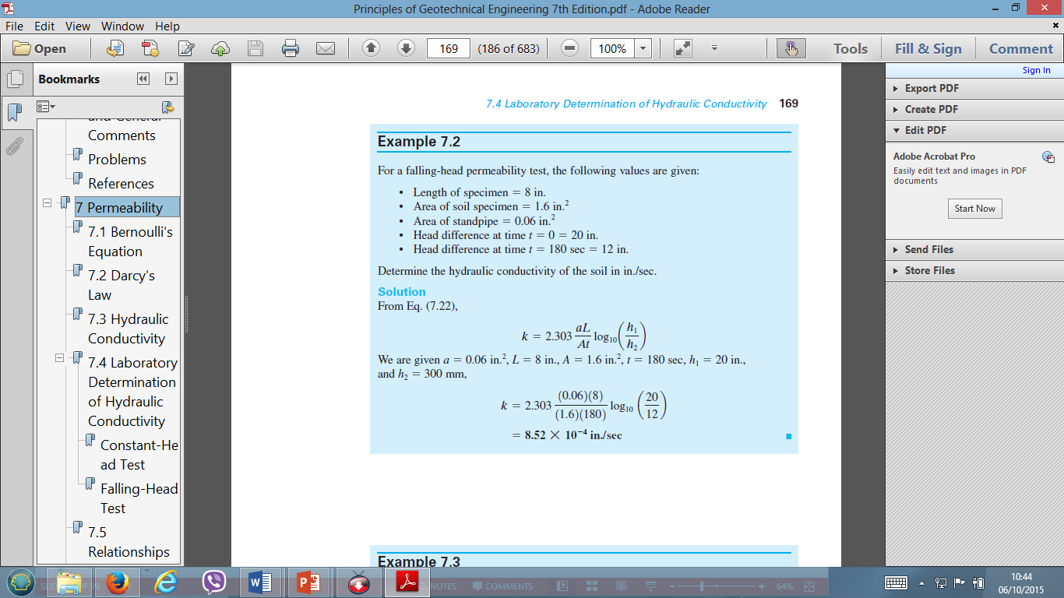
Exercise

Slide 45
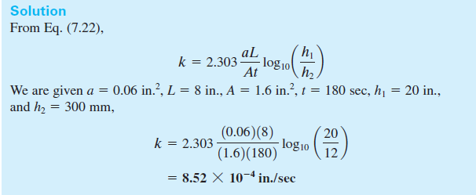
Examples
For a falling-head permeability test, the following values are given:
• Length of specimen 8 in.
• Area of soil specimen 1.6 in.2
• Area of standpipe 0.06 in.2
• Head difference at time t 0 20 in.
• Head difference at time t 180 sec 12 in.
Determine the hydraulic conductivity of the soil in in./sec.

Slide 46
Home Work
Examples 7.1 to 7.5 → Das, Chapter 7

Slide 47
Exercise
A constant head permeability test was carried out on a cylindrical sample of sand 5 cm in diameter and 15 cm in height. 40 cm³ of water was collected in 5 secs, under a head of 30 cm. Compute the hydraulic conductivity in cm/s and the velocity of flow in cm/sec if porosity is 0.6.

Slide 48
Problems
1. A 300mm diameter test well penetrates 27 m below the static water table. After 24 hours of pumping at 69 litres/sec, the water level in an observation well at a distance of 95m form the test well is lowered 0.5 m and the other observation well at a distance of 35m m form the test well at a distance of 35 m from the test well, the drawdown is 1.1 m.
a. What is the rate of flow in cubic meters per day?
b. Compute the coefficient of permeability of the aquifer in meters per day.

Slide 49
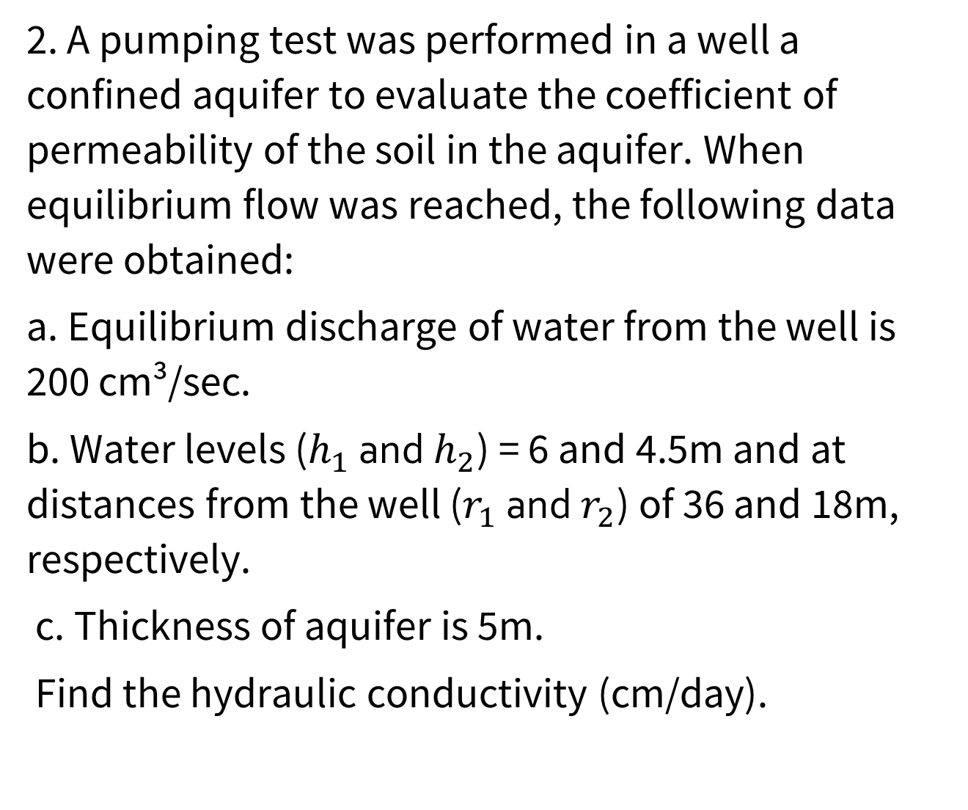
Problems
2. A pumping test was performed in a well a confined aquifer to evaluate the coefficient of permeability of the soil in the aquifer. When equilibrium flow was reached, the following data were obtained:
a. Equilibrium discharge of water from the well is 200 cm³/sec.
b. Water levels ($h_{1}$ and $h_{2}$) = 6 and 4.5m and at distances from the well ($r_{1}$ and $r_{2}$) of 36 and 18m, respectively.
c. Thickness of aquifer is 5m.
Find the hydraulic conductivity (cm/day).

Slide 50
Problems
4. A well is constructed to pump water from a confined aquifer. Two observation wells are constructed at distances of 100 m and 1000 m respectively. Water is pump from the pumping well at a rate of 0.2 m³ /min. At steady state, the drawdown is observed as 2m and 8m respectively in the farthest and the nearest observation wells. Diameter of the test well is 1m. The thickness of the aquifer is 20 m.
a. Determine the hydraulic conductivity in cm/sec.
b. Determine the transmissivity in cm²/sec.
c. Determine the drawdown in the test well.

Slide 51
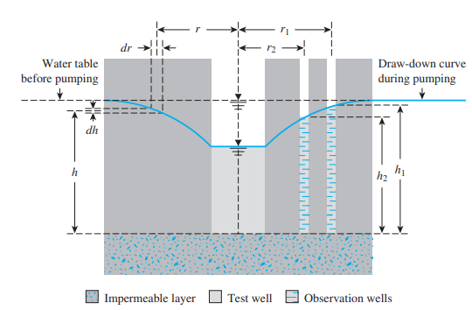
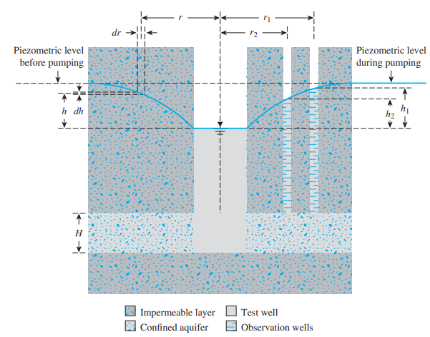
Problems

Slide 52
Problems
5. A certain 20 m thick sandy aquifer has a transmissivity of 0.12 m²/sec and a void ratio of 0.91. Ground water is flowing through this aquifer with a hydraulic gradient of 0.0065.
a. Compute the hydraulic conductivity of the sand aquifer.
b. Compute the seepage velocity.
c. How much time would be required for water to travel 1km through this aquifer?

Slide 53
Problems
6. Refer to the constant-head arrangement shown in Figure 7.5. For a test, the following are given.
L =18 in.
A = area of the specimen = 3.5 in.2
Constant-head difference, h = 28 in.
Water collected in 3 min = 21.58 in.3. Calculate the hydraulic conductivity (in./sec).

Slide 54
Problems
7. For a falling-head permeability test, the following are given:
• Length of the soil specimen = 20 in.
• Area of the soil specimen = 4 in.2
• Area of the standpipe = 0.2 in.2
• Head difference at time t = 0 is 30 in.
• Head difference at time t = 10 min is 12 in.
Determine the hydraulic conductivity of the soil (in./min).
What was the head difference at time t = 5 min?

Slide 55
Try Problems
1. At one location on the ground a porous layer lies above an impervious stratum. The thickness of this porous layer is 7 meters. Water table also lies in the porous layer and it is at the depth of 1.5 m below the ground surface. A test well is drilled into the ground which penetrates the whole thickness of this permeable layer. Through this well the water is pumped out at the rate of 100 litres/sec. The drawdown of the water table because of this pumping out is observed by making observation wells at a distance of 7 m and 21 m from the test well. The drawdown observed at 7 m is 3 m and at 21 m it is 0.8 m.
What is the coefficient of permeability of that porous layer of soil?

Slide 56
Try Problems
2. At one location on the ground a porous layer is observed between two impervious layers of soil. The porous layer, which has the thickness of 4 m, lies under the impervious soil layer of thickness 5 m. A test well is drilled into the ground which penetrates the whole thickness of this permeable layer. Through this well the water is pumped out at the rate of 20 L/sec. The influence of this pumping out on water level is observed by making observation wells at a distance of 5 m and 11 m from the test well. The water level in these well is observed at 3.5 m and 3m below the ground surface in 5 m and 11 m distant well respectively. What is the coefficient of permeability of that porous layer of soil?

Slide 57
Try Problems
3. For a falling-head permeability test, the following are given:
• Length of soil specimen = 700 mm
• Area of the soil specimen = 20 cm2
• Area of the standpipe = 1.05 cm2
• Head difference at time t = 0 is 800 mm
• Head difference at time t = 8 min is 500 mm
Determine the absolute permeability of the soil.
What is the head difference at time t 6 min? Assume that the test was conducted at 20℃, and at 20℃, 𝛾_𝑤 = 9.789 kN/m3 and 𝜂 = 1.005 x 10-3 N.s/m2 .

